Slide 1

Presentation for Mini Project
Submitted By : Course :
Apurv Tewari (1961208) B. Tech. (CSE)
Mohit Negi(1961107) 5th sem
Neeraj Kumaiya(1961112)

Slide 2
Job Crawler using Data Scrapping
In Python and MongoDB

Slide 3
Introduction
The project here is a terminal based program written in Python language and all the data stored in MongoDB(database program). Job crawlers unleash the potential of the age-old crawling techniques in the recruitment parlance to translate the power of this technology in finding the most niche, latest, and relevant job feeds for job portals.
Requirements :
1. Python 3.2 and above
2. PyCharm IDE
3. MongoDB server

Slide 4
Objective and Scope
The project here is a Web Scrapping program written in Python language and all the data stored in MongoDB(database program). Job crawlers unleash the potential of the age-old crawling techniques in the recruitment parlance to translate the power of this technology in finding the most niche, latest, and relevant job feeds for job portals.
The program runs natively on the system itself, where the packages used by the program i.e., Beautiful Soup modules have been setup within the environment of the Operating System.
Web scraping is the process of gathering information from the Internet. Even copy-pasting the lyrics of your favorite song is a form of web scraping! However, the words “web scraping” usually refer to a process that involves automation. Some websites don’t like it when automatic scrapers gather their data, while others don’t mind.
The model behind relies on Beautiful soup package.
Job Crawlers unleash the potential of the age-old crawling techniques in the recruitment parlance to translate the power of this technology in finding the most niche, latest, and relevant job feeds for job portals.

Slide 5
Some website providers offer Application Programming Interfaces (APIs) that allow you to access their data in a predefined manner. With APIs, you can avoid parsing HTML and instead access the data directly using formats like JSON and XML. HTML is primarily a way to visually present content to users.
When you use an API, the process is generally more stable than gathering the data through web scraping. That’s because APIs are made to be consumed by programs, rather than by human eyes. If the design of a website changes, then it doesn’t mean that the structure of the API has changed.
However, APIs can change as well. Both the challenges of variety and durability apply to APIs just as they do to websites. Additionally, it’s much harder to inspect the structure of an API by yourself if the provided documentation is lacking in quality.
The approach and tools you need to gather information using APIs are outside the scope of this tutorial. To learn more about it, check out API Integration in Python.
Beautiful Soup is packed with useful functionality to parse HTML data. It’s a trusted and helpful companion for your web scraping adventures. Its documentation is comprehensive and relatively user-friendly to get started with. You’ll find that Beautiful Soup will cater to most of your parsing needs, from navigating to advanced searching through the results.

Slide 6
Methodology/ Process Description
Libraries Used:
import requests :
Requests allows you to send HTTP/1.1 requests extremely easily. There’s no need to manually add query strings to your URLs, or to form-encode your PUT & POST data — but nowadays, just use the json method!
Requests is one of the most downloaded Python package today, pulling in around 14M downloads / week— according to GitHub, Requests is currently depended upon by 500,000+ repositories. You may certainly put your trust in this code.
2. import BeautifulSoup :
Beautiful Soup is a library that makes it easy to scrape information from web pages. It sits atop an HTML or XML parser, providing Pythonic idioms for iterating, searching, and modifying the parse tree.
3. import pymongo :
The PyMongo distribution contains tools for interacting with MongoDB database from Python. The bson package is an implementation of the BSON format for Python. The pymongo package is a native Python driver for MongoDB. The gridfs package is a gridfs implementation on top of pymongo.
PyMongo supports MongoDB 2.6, 3.0, 3.2, 3.4, 3.6, 4.0, 4.2, and 4.4.

Slide 7
Resources Used
Software Used:
Pycharm ID
Python 3.2 and above
MangoDB (Cloud based Database Management System)
Hardware Used:
Laptop
Internet Connection
Wi-fi

Slide 8
Setting up the Environment
Step 1:
Extracting all the URL from a specific webpage using Python.
Extracting all links of a web page is a common task among web scrapers, it is useful to build advanced scrapers that crawl every page of a certain website to extract data, it can also be used for SEO diagnostics process or even information gathering phase for penetration testers. In this tutorial, you will learn how you can build a link extractor tool in Python from Scratch using only requests and BeautifulSoup libraries.
Step 2:
Integrating Pycharm ID to the MongoDB server.
1. Install Python Driver – PyMongo
2. Import MongoClient from pymongo
3. Create a connection to MongoDB Daemon Service using MongoClient
4. MongoClient is Ready

Slide 9
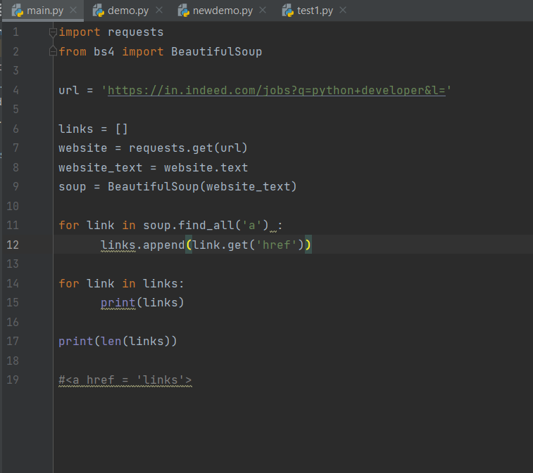
Code

Slide 10
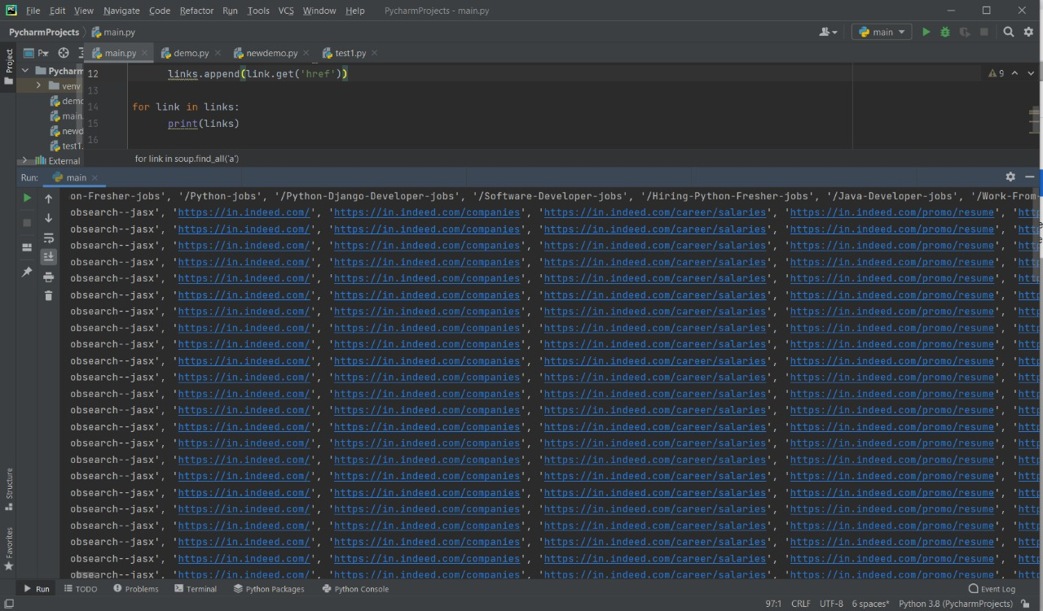
After scrapping data from different webpages we got number of URL's most of them are not of our use but our project (JOB CRAWLER) will scrap useful URL's from it in the final process.
After running the code on (https://in.indeed.com/jobs?q=python+developer&l=) webpage we got 237 urls as shown below.

Slide 11
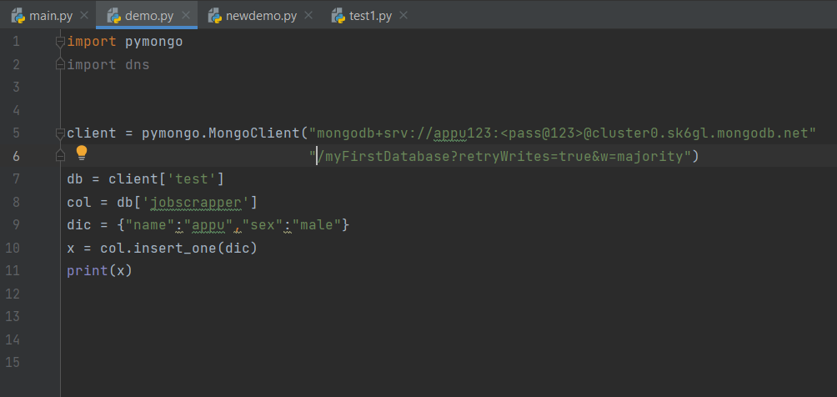
Python Script – To demonstrate Connection to MongoDB

Slide 12
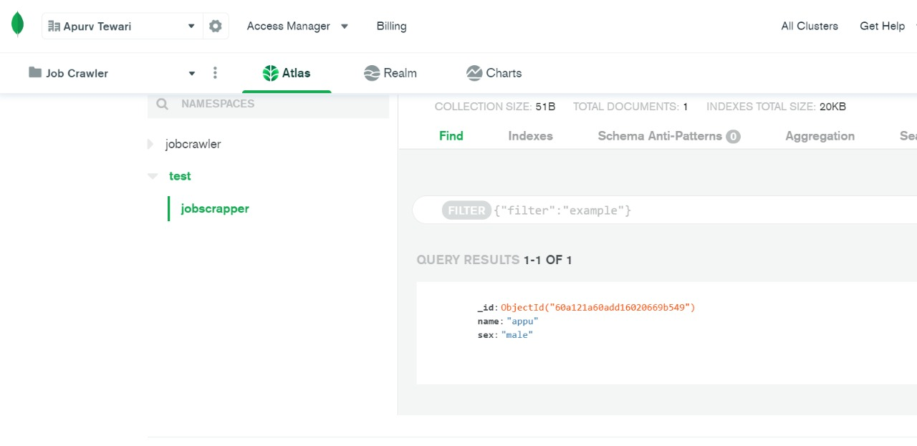
Console Output (MongoDB Server)

Slide 13
Final Process
Jobs Crawler : A simple crawler for job ads on different websites.
Configuration : The configuration for search terms, location and which websites to include can be set in the config.json file. An example of the configuration is shown below:
NOTE
Any website does only support certain countries. For a full list of supported countries for each site view the mapping files crawler/monster_mapping.json and crawler/neuvoo_mappings.json. If a country is specified that is supported for one website but not the other, the crawler will only crawl the supported one.

Slide 14
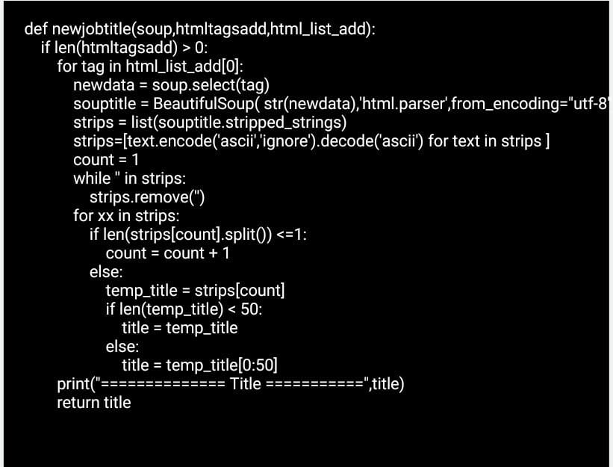
Run

Slide 15
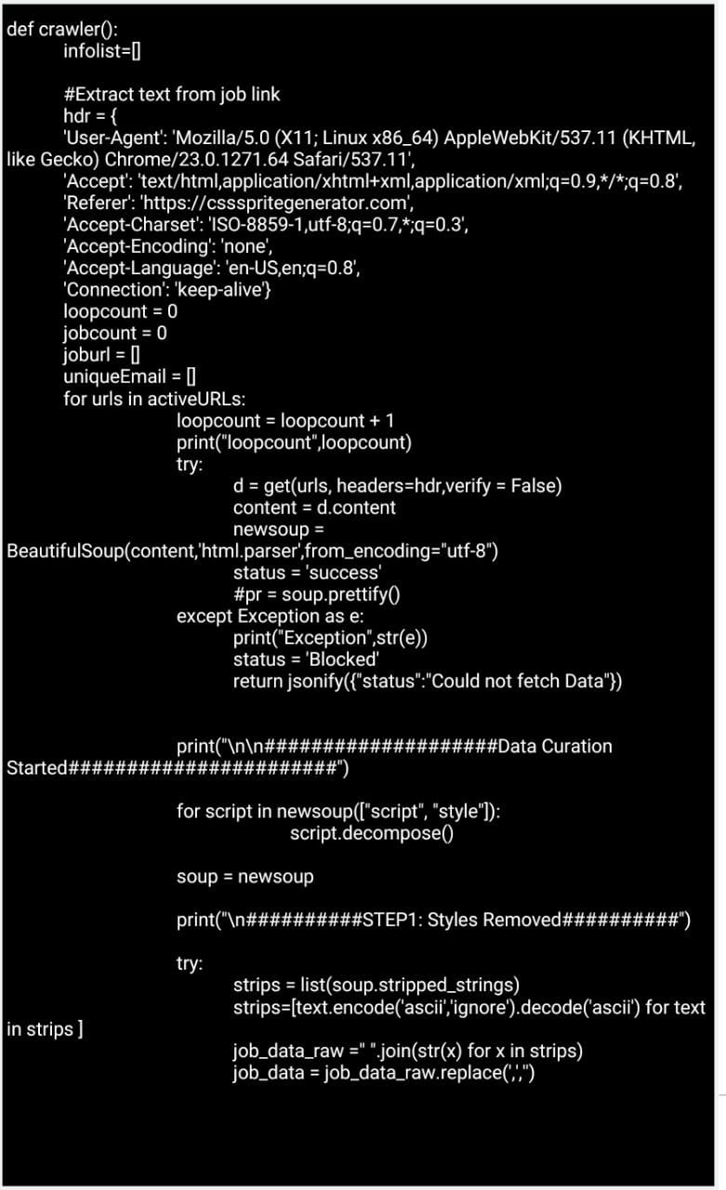

Slide 16
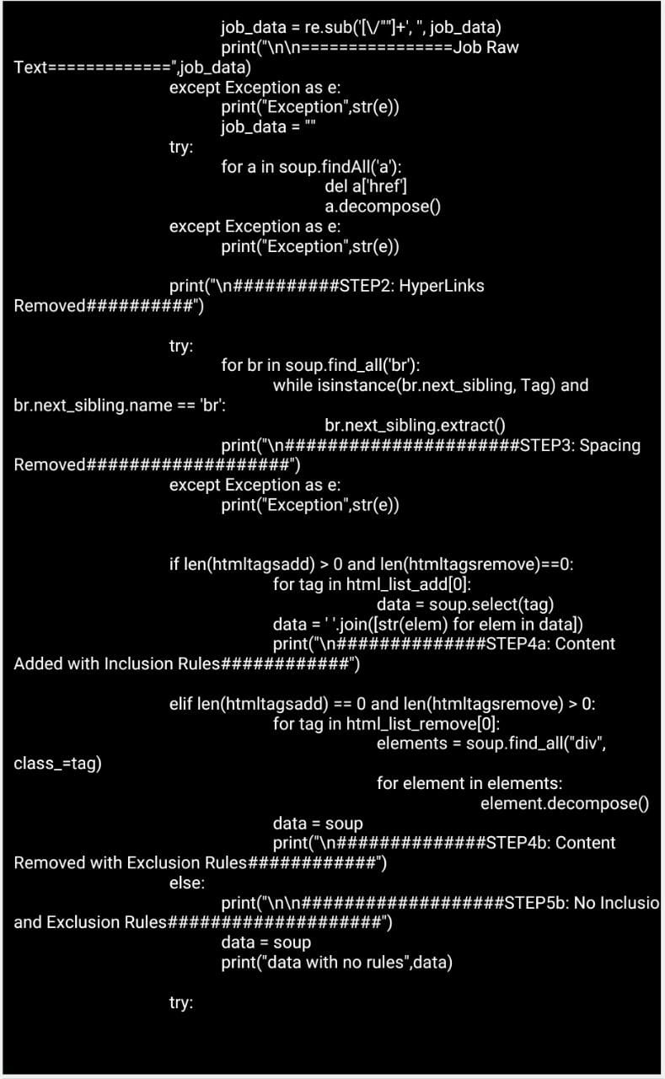

Slide 17
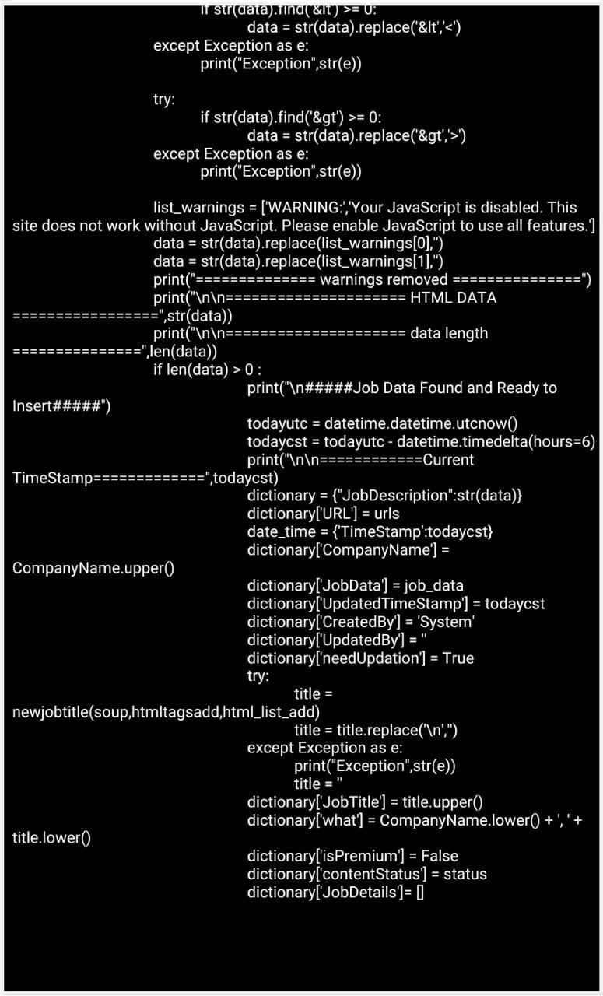

Slide 18

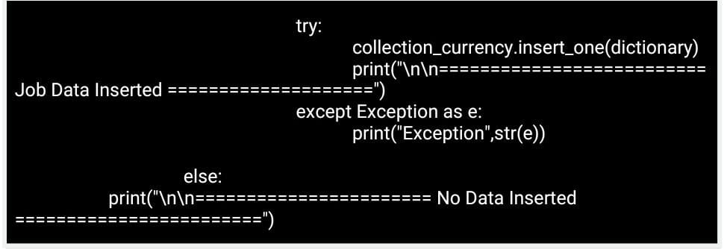

Slide 19
Output
The crawled data is stored in MongoDB database server. All newly received job ads are also written to an output file with the name specified in the configuration file, however, only new ads will be outputed to that file.
After scrapping all the URL’s from the required websites, now using our final code we are filtering those URL with the logic of CSS selector and HTML tag into job description object ID and URL and the final result is shown in the images given below :

Slide 20
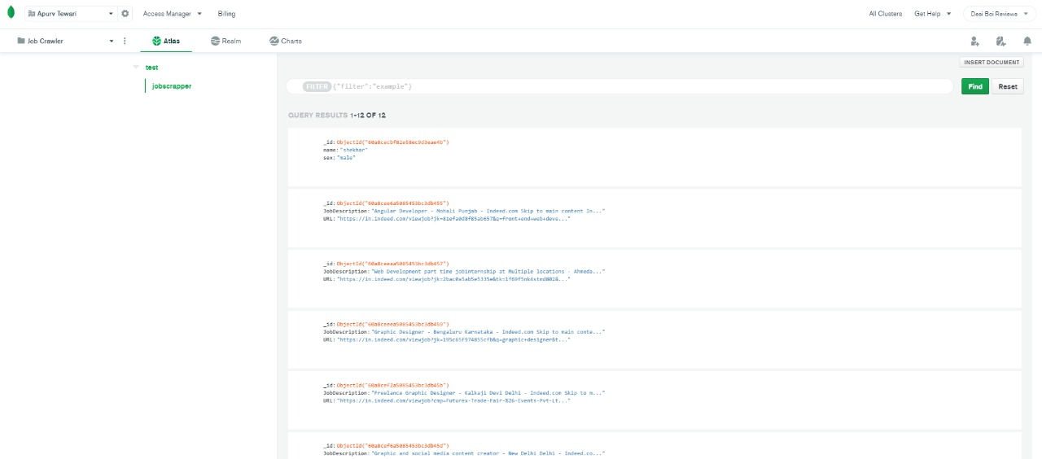

Slide 21
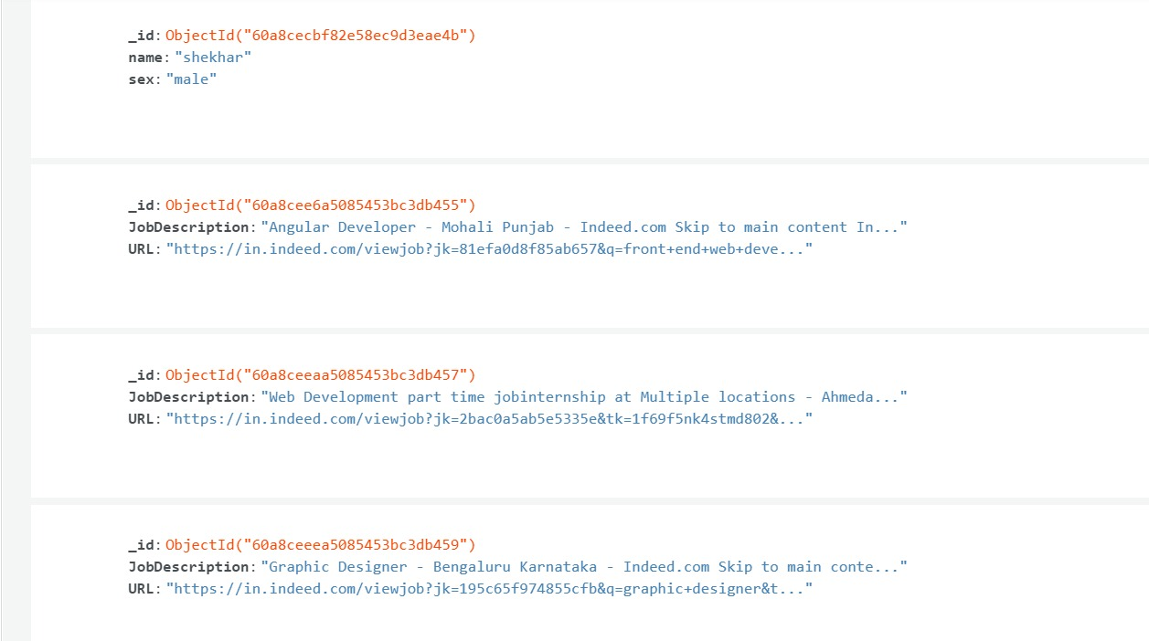

Slide 22
THANK YOU

